Slide 1
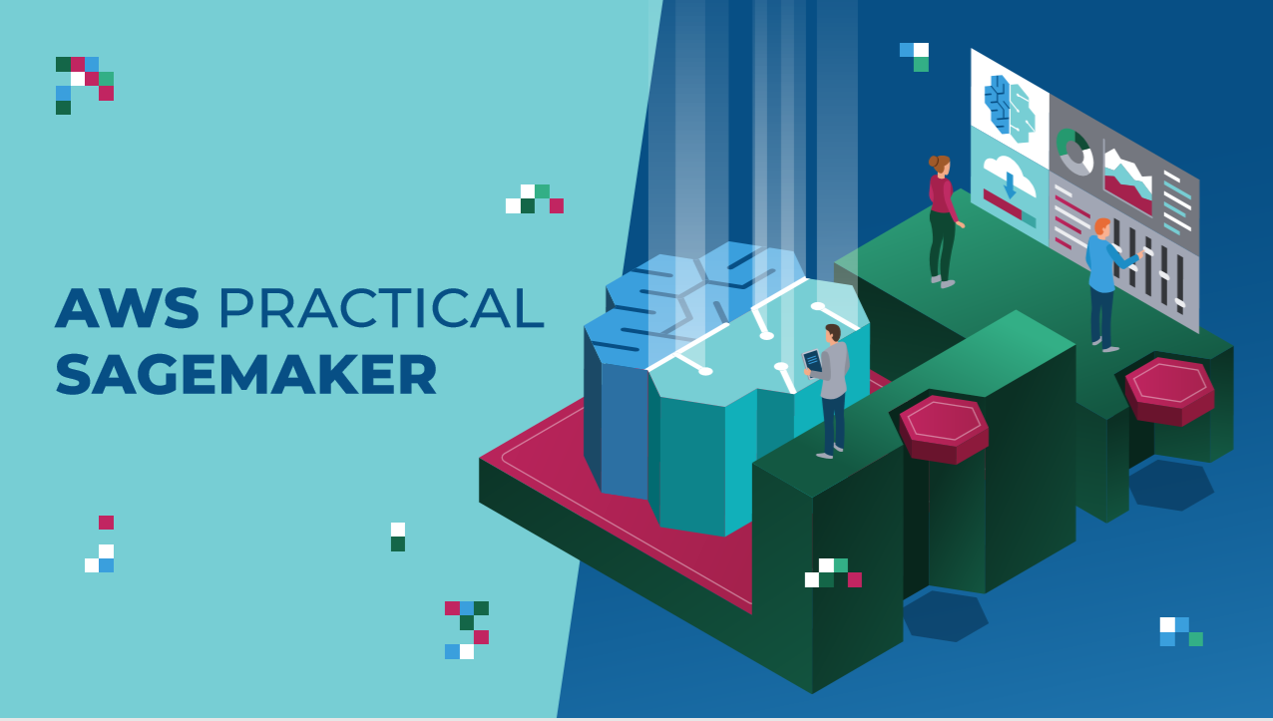

Slide 2

INTRODUCTION: AGENDA
HOW TO DOWNLOAD THE COURSE MATERIAL?
WHAT’S INCLUDED IN THE COURSE PACKAGE?
HOW TO SUCCEED IN THIS COURSE?
BEST PRACTICES
HOW TO GET HELP/ASK QUESTIONS
HOW TO RECEIVE CERTIFICATE OF COMPLETION?

Slide 3
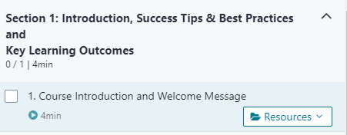
HOW TO DOWNLOAD THE COURSE MATERIALS?
COURSE PACKAGE (SLIDES, CODES, AND DATASET)

Slide 4
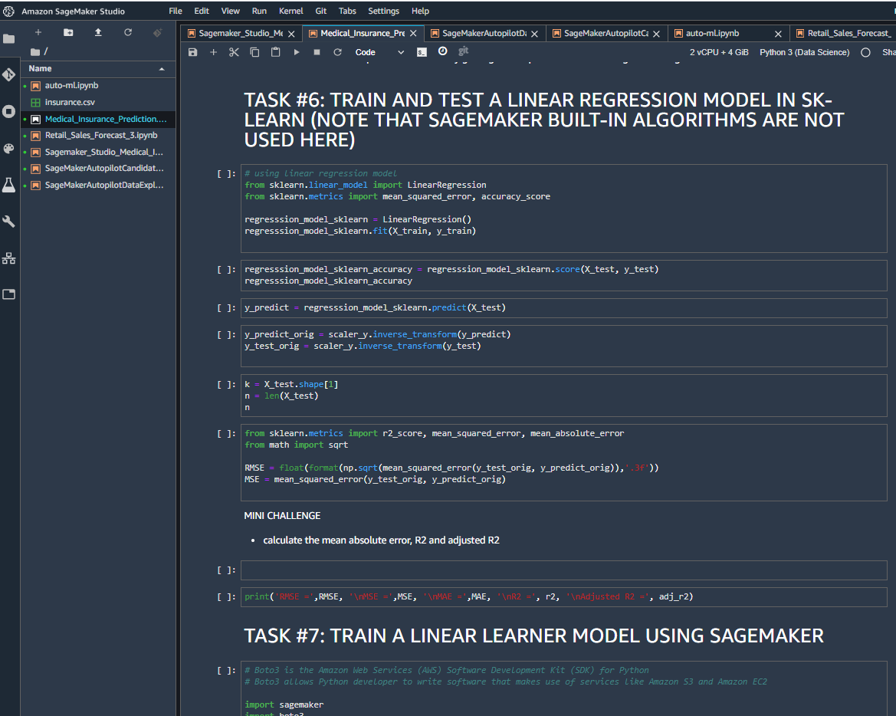
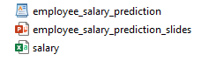
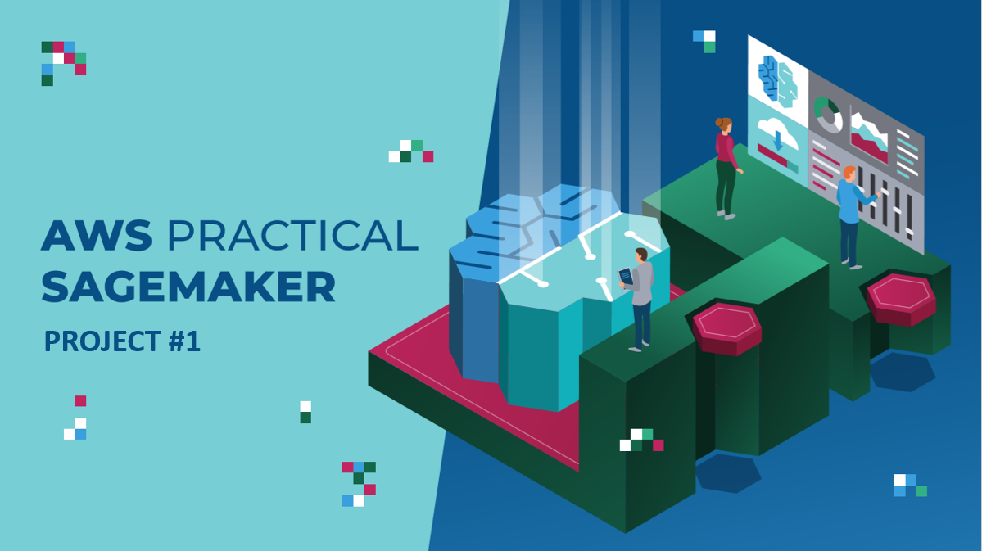
INTRODUCTION: WHAT’S INCLUDED IN THE COURSE PACKAGE?
JUPYTER NOTEBOOKS
PROJECT SLIDES
DATASET

Slide 5
HOW TO SUCCEED IN THIS COURSE?
FOR PROJECTS:
Step #1: Start with the Jupyter notebook and run cells OR code along with me while watching the videos.
FOR MINI CHALLENGES:
Step #1: Attempt to solve the challenge on your own.
Step #2: Compare your answers with solutions notebook while watching the solutions video lecture.

Slide 6
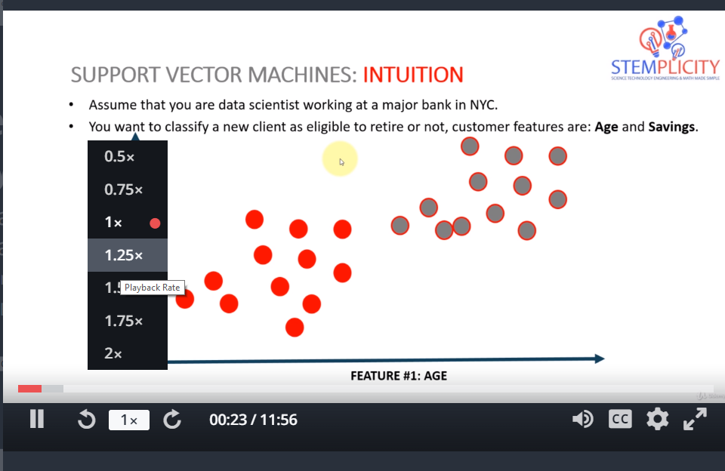
BEST PRACTICES: CHANGE VIDEO SPEEDS
You have the option to play the lectures at different speeds: (.5x, 1x, 1.25x, 1.5x or 2x)
In the bottom-left corner of the video, you can select change the speed of the video.

Slide 7
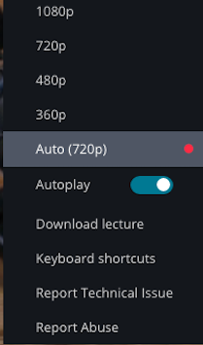
BEST PRACTICES: CHANGE THE VIDEO PLAYBACK QUALITY
Udemy automatically optimizes video resolution based on your internet connection speed.
Alternatively, you can select resolutions of 360p, 480p, 720p and 1080p for the video quality.
All course lectures are filmed with HD quality 1080p.

Slide 8
BEST PRACTICES: HOW TO REACH OUT FOR HELP WITH UDEMY PLATFORM ISSUES?
No control over platform issues
If you encounter any platform problems, please e-mail support at:
support@udemy.com

Slide 9
HOW TO GET HELP AND ASK QUESTIONS?
Step#1: Check the lecture videos for answers
Step#2: Search the previous Q&A
Step#3: Search StackOverflow for error messages
Step#4: Post in Q&A and our team will be happy to help you out
NOTE: PLEASE INCLUDE A SCREENSHOT OF THE ERROR AND LECTURE NUMBER

Slide 10
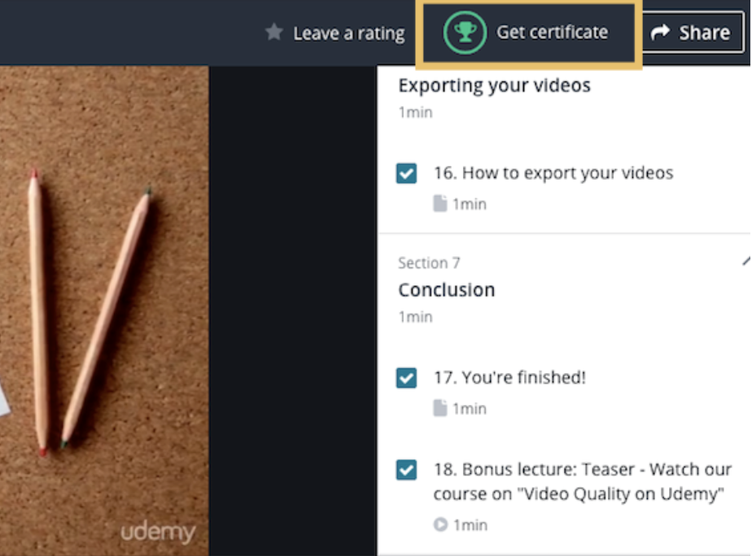
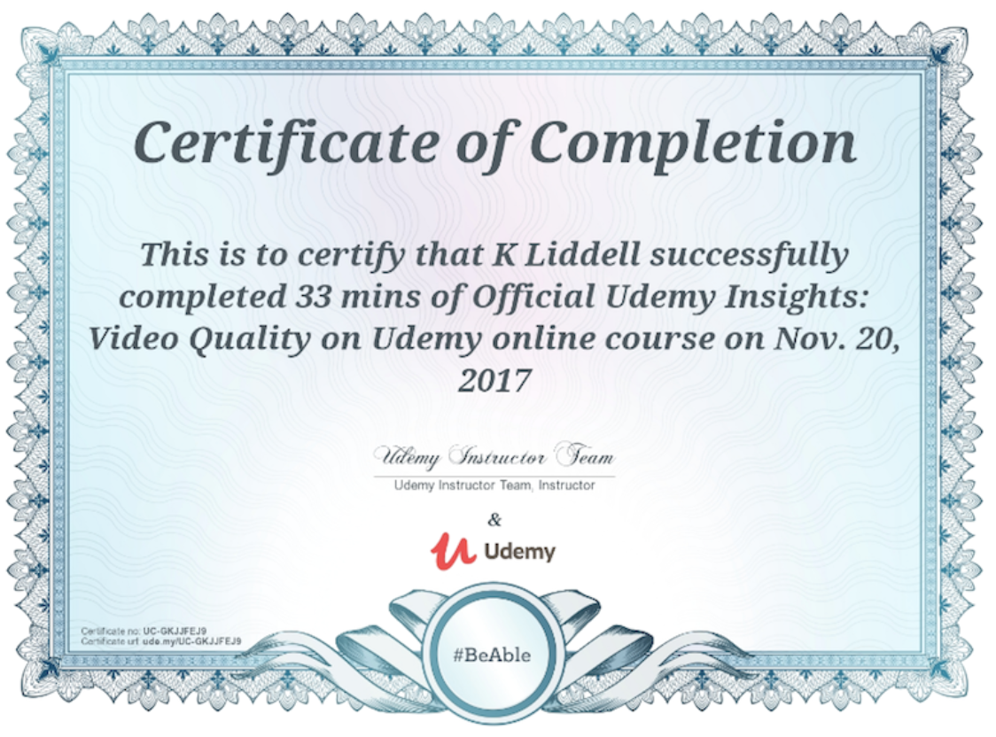
HOW TO GET CERTIFICATE OF COMPLETION?
When you complete this course, you will receive a certificate of completion.
You can share it with co-workers and potential employers.
When all curriculum items of have been completed, a green trophy will appear on the course dashboard, indicating that the certificate of completion is ready.
More information: https://support.udemy.com/hc/en-us/articles/229603868-Certificate-of-Completion

